Slide 1
Week 1 Lab
Use Apache Axis to create a web calculator service and a client to consume the service.
Github link
Yamani Nikhil Chowdary
AP20110010067

Slide 2
Problem Overview
The problem statement is to create a web service using Apache axis and develop a web calculator.
•Steps:
1.Install Eclipse IDE, Tomcat Version 9 and Apache Axis2
2.Open Eclipse, and set the environment
3.Create the server and then write the java code for calculator
4.Run the sever, use it from client side

Slide 3
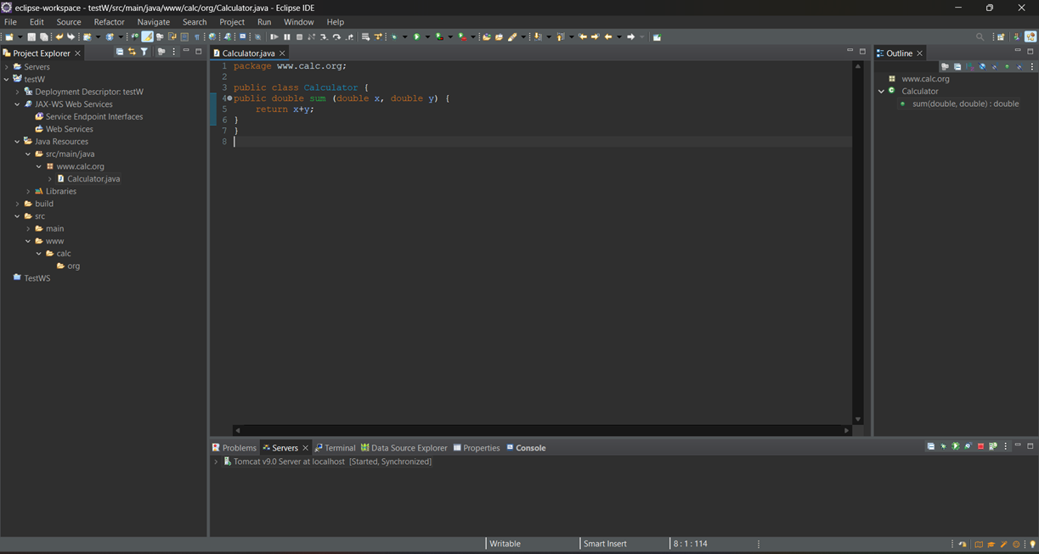
Output

Slide 4
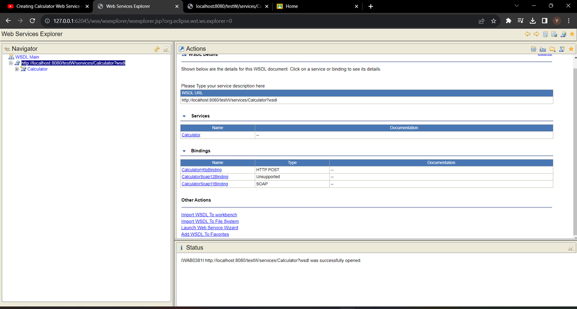
Server

Slide 5
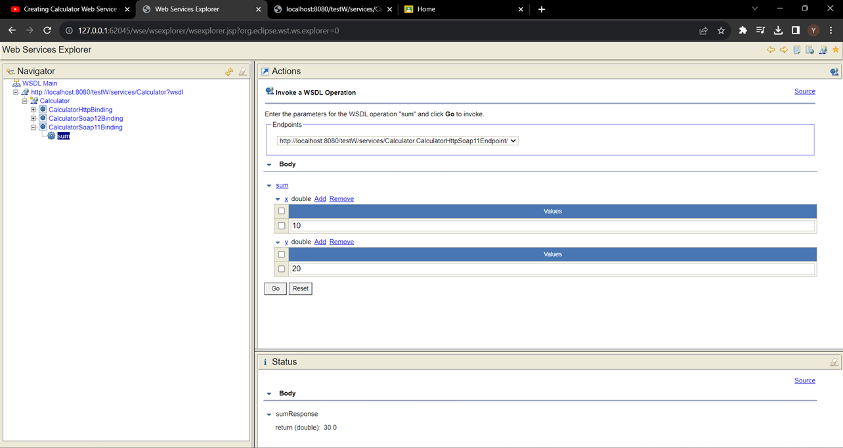
Client side Output

Slide 6
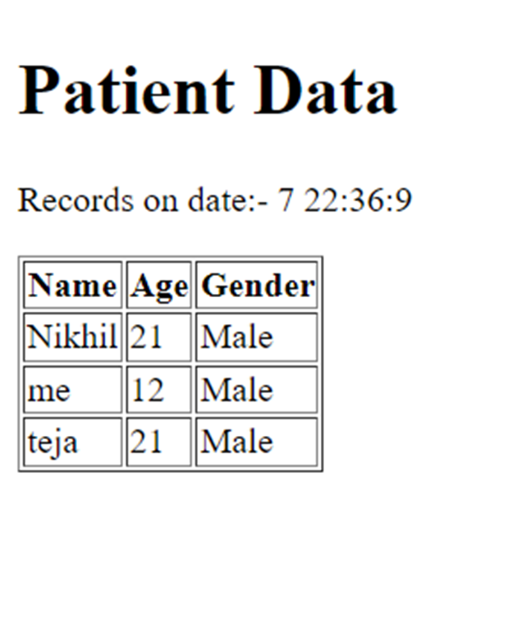
Step 4
In the end, the complete contents of the XML file are showcased within an HTML page.

